Slide 1
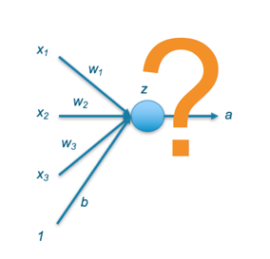
3D Computer Vision Induction Workshop
Module 3: Intro to Neural Networks
Introduction to Loss Functions, Regularization and Normalization

Slide 2
Plan
Neural Network Learning as Optimization
Loss Function
Which loss function to use ?
Generalisation, Overfitting & Underfitting
Regularization
Dropout
Early Stopping
Normalization
Activation Functions
Visualizing MNIST Weights

Slide 3
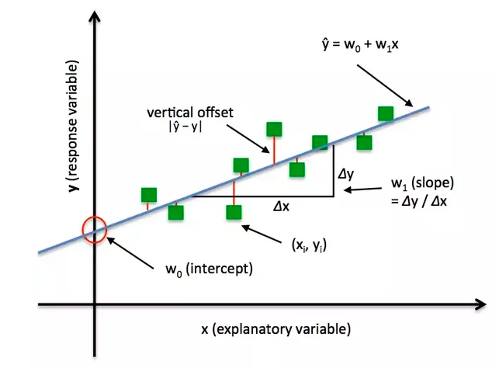
Neural Network Learning as Optimization
A deep learning neural network learns to map a set of inputs to a set of outputs from training data.
We cannot calculate the perfect weights for a neural network; there are too many unknowns. Instead, the problem of learning is cast as a search or optimization problem and an algorithm is used to navigate the space of possible sets of weights the model may use in order to make good or good enough predictions.

Slide 4
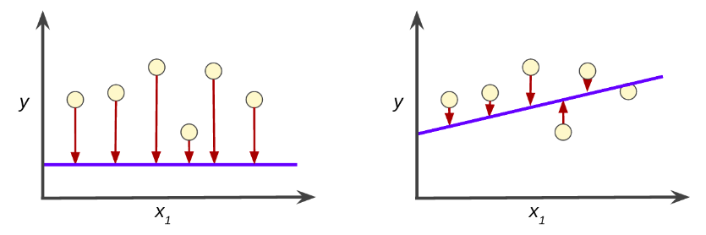
What is a Loss and Loss Function?
Loss is the penalty for a bad prediction. That is, loss is a number indicating how bad the model's prediction was on a single example. If the model's prediction is perfect, the loss is zero; otherwise, the loss is greater. The goal of training a model is to find a set of weights and biases that have low loss, on average, across all examples.

Slide 5
Minimizing Loss as an Optimization Problem
Our objective is to minimize the loss for a neural network by optimizing its parameters (weights).
The loss is calculated using loss function/cost function. Every neural network gives us some output, we calculate the loss by matching this output with actual output (target value).
J(w) = ytrue - ypred
Then we use the gradient descent method to optimize the weights of the network such that this loss is minimized. This is how we train a neural network.
Let us now look into various loss functions.

Slide 6
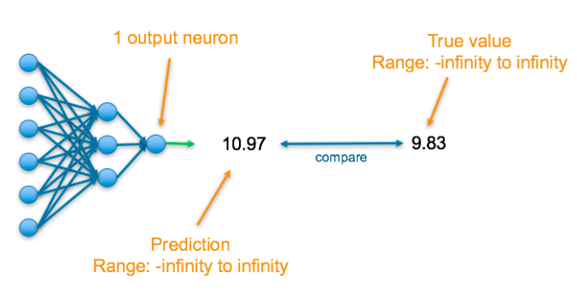
Which Loss Function to Use?
Are you trying to predict a value (Regression) or a categorical outcome ?

Slide 7
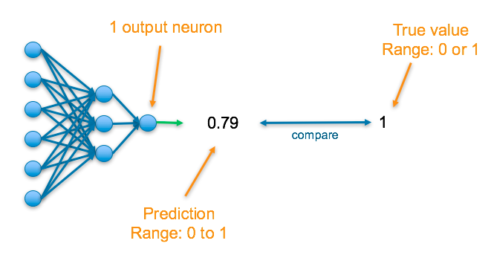
Which Loss Function to Use?
Are you trying to predict a value or a categorical outcome (Classification) ?

Slide 8
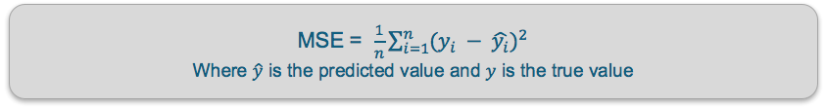
Loss function for Regression
Mean Absolute Error Loss (MAE)/ L1 Loss — This finds the average of the absolute difference between the actual and predicted values.
Mean squared error (MSE)/ L2 Loss — This finds the average squared difference between the predicted value and the true value.

Slide 9

Loss for Regression
Mean Absolute Error Loss (MAE)/ L1 Loss — This finds the average of the absolute difference between the actual and predicted values.
Mean squared error (MSE)/ L2 Loss — This finds the average squared difference between the predicted value and the true value.
Loss for Classification
Binary Cross Entropy — Cross entropy quantifies the difference between two probability distribution. Our model predicts a model distribution of {p, 1-p} as we have a binary distribution. We use binary cross-entropy to compare this with the true distribution {y, 1-y}

Slide 10
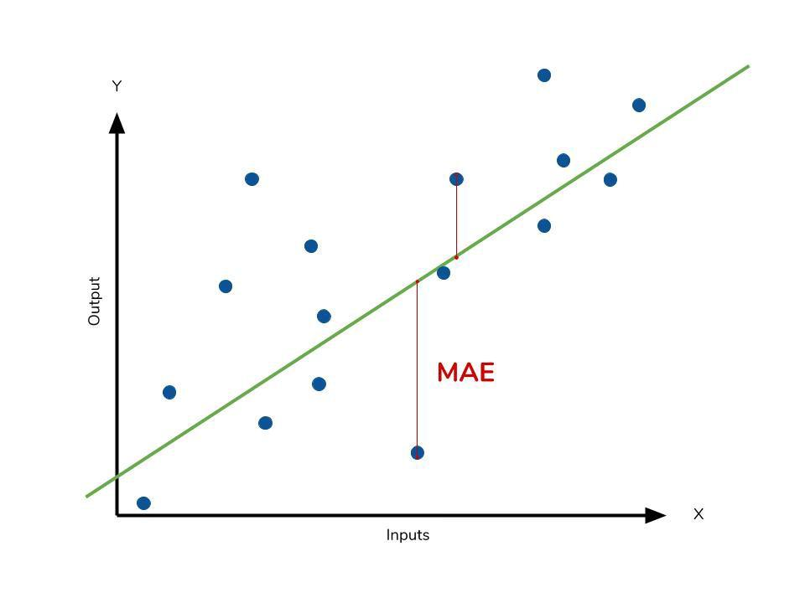

Slide 11
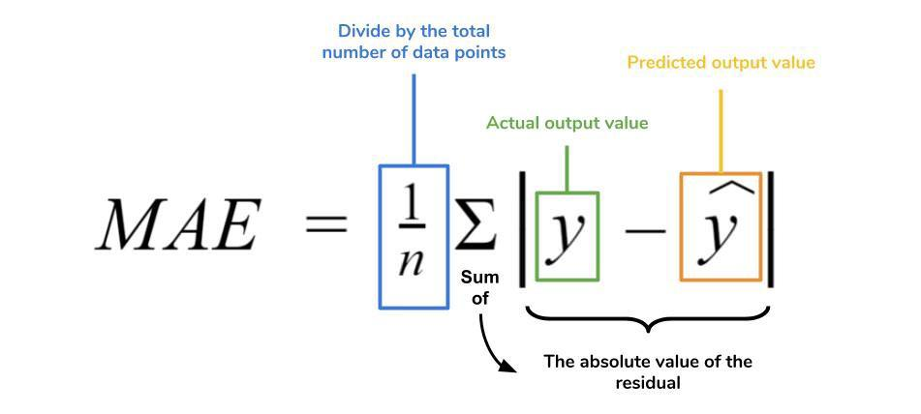

Slide 12
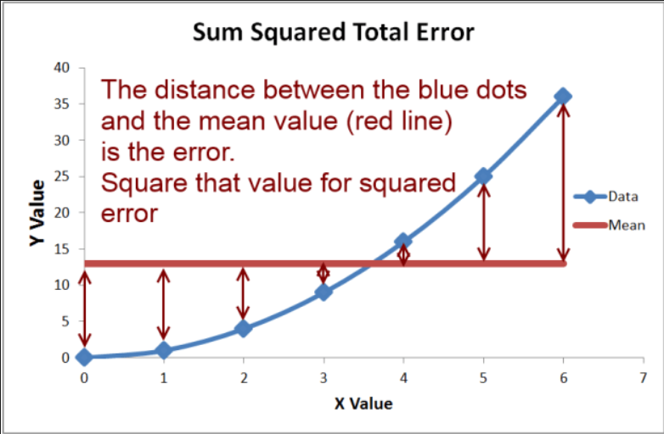

Slide 13
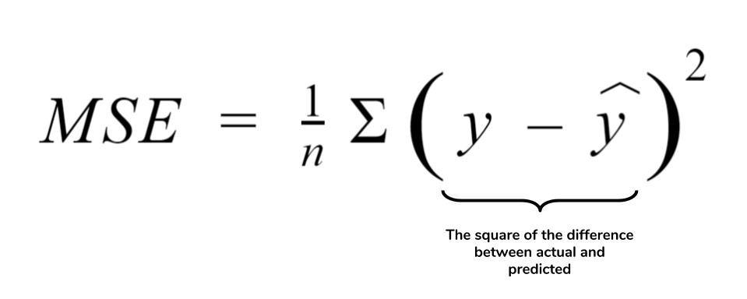
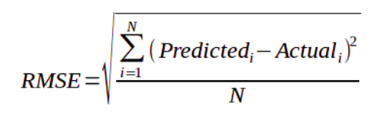

Slide 14
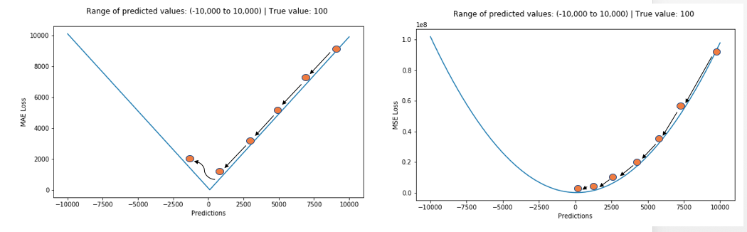
MSE vs MAE
L1 loss is more robust to outliers, but its derivatives are not continuous, making it inefficient to find the solution. L2 loss is sensitive to outliers, but gives a more stable and closed form solution (by setting its derivative to 0.)

Slide 15
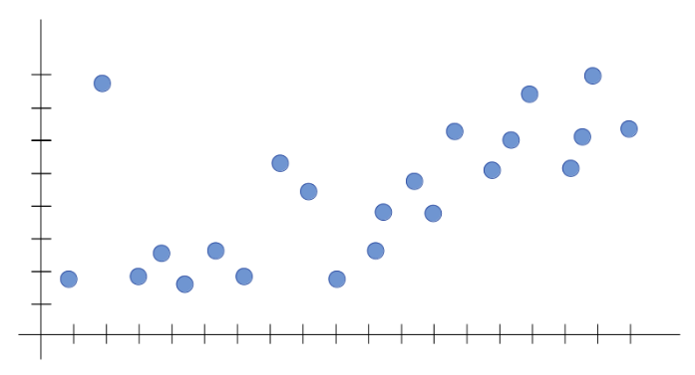
Generalisation, Underfitting and Overfitting
Let’s say we’re trying to build a Machine Learning model for the following data set.

Slide 16
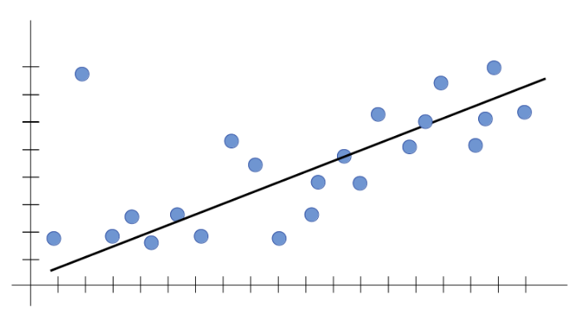
Generalisation
Suppose, we fit a line on the given training data.

Slide 17
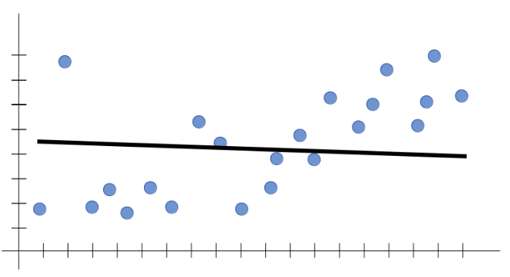
Underfitting
Underfitting is the case where the model has “not learned enough” from the training data, resulting in low generalization and unreliable predictions.

Slide 18
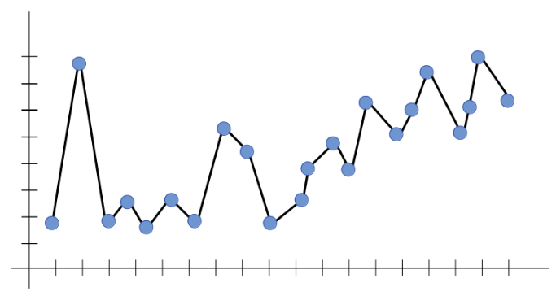
Overfitting
Overfitting is the case where the overall cost is really small, but the generalization of the model is unreliable. This is due to the model learning “too much” from the training data set.

Slide 19
Possible Causes of Overfitting
An excessive number of features, however, can cause a neural network to overfit
Large number of parameters in a model
Less training data with a complex model
Tricks to avoid overfitting:
More training data
Train a less complex model
Regularization
Dropout
Early Stopping

Slide 20
Regularization
A model that generalizes well is a model that is neither underfit nor overfit.
Regularization reduces over-fitting by adding a penalty to the loss function.
Mathematically speaking, it adds a regularization term in order to prevent the coefficients to fit so perfectly to overfit.
There are basically two types of regularization, namely
L1 regularization / Lasso regularization
L2 regularization / Ridge regularization
lambda (λ) is called as regularization parameter and is one of the hyperparameters that we need to tune.
Which to use:
If all the features are correlated with the label, ridge outperforms lasso, as the coefficients are never zero in ridge. If only a subset of features are correlated with the label, lasso outperforms ridge as in lasso model some coefficient can be shrunken to zero.

Slide 21
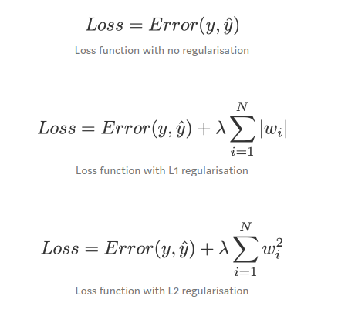
L1 and L2 Regularization
A linear regression model that implements L1 norm for regularisation is called lasso regression, and one that implements (squared) L2 norm for regularisation is called ridge regression.
Difference between L1 and L2
L2 (Ridge) shrinks all the coefficient by the same proportions but eliminates none, while L1 (Lasso) can shrink some coefficients to zero, performing variable selection.

Slide 22
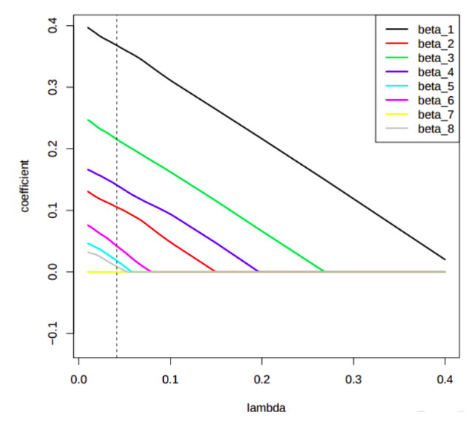
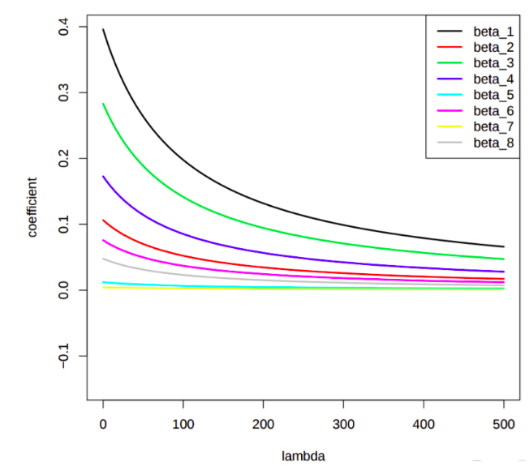
L1 and L2 Regularization

Slide 23
Dropout
Dropout is an approach to regularization in neural networks which helps reducing interdependent learning amongst the neurons.
Dropout is a technique where randomly selected neurons are ignored during training. They are “dropped-out” randomly.
This means that their contribution to the activation of downstream neurons is temporarily removed on the forward pass and any weight updates are not applied to the neuron on the backward pass.
Most importantly. Dropout is only used during the training of a model and is not used when evaluating the model.
More technically, At each training stage, individual nodes are either dropped out of the net with probability 1-p or kept with probability p, so that a reduced network is left; incoming and outgoing edges to a dropped-out node are also removed.

Slide 24
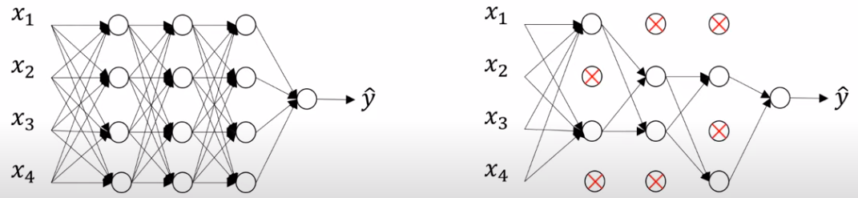
Dropout

Slide 25
Early Stopping
One of the biggest problem in training neural network is how long to train the model.
Training too little will lead to underfit in train and test sets. Training too much will have the overfit in training set and poor result in test sets.
Here the challenge is to train the network long enough that it is capable of learning the mapping from inputs to outputs, but not training the model so long that it overfits the training data.
One possible solution to solve this problem is to treat the number of training epochs as a hyperparameter and train the model multiple times with different values, then select the number of epochs that result in the best accuracy on the train or a holdout test dataset, But the problem is it requires multiple models to be trained and discarded.
One alternative technique to prevent overfitting is use validation error to decide when to stop. This approach is called Early Stopping.

Slide 26
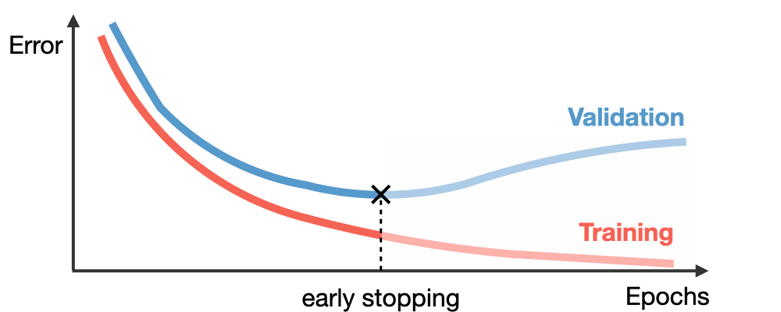
Early Stopping

Slide 27
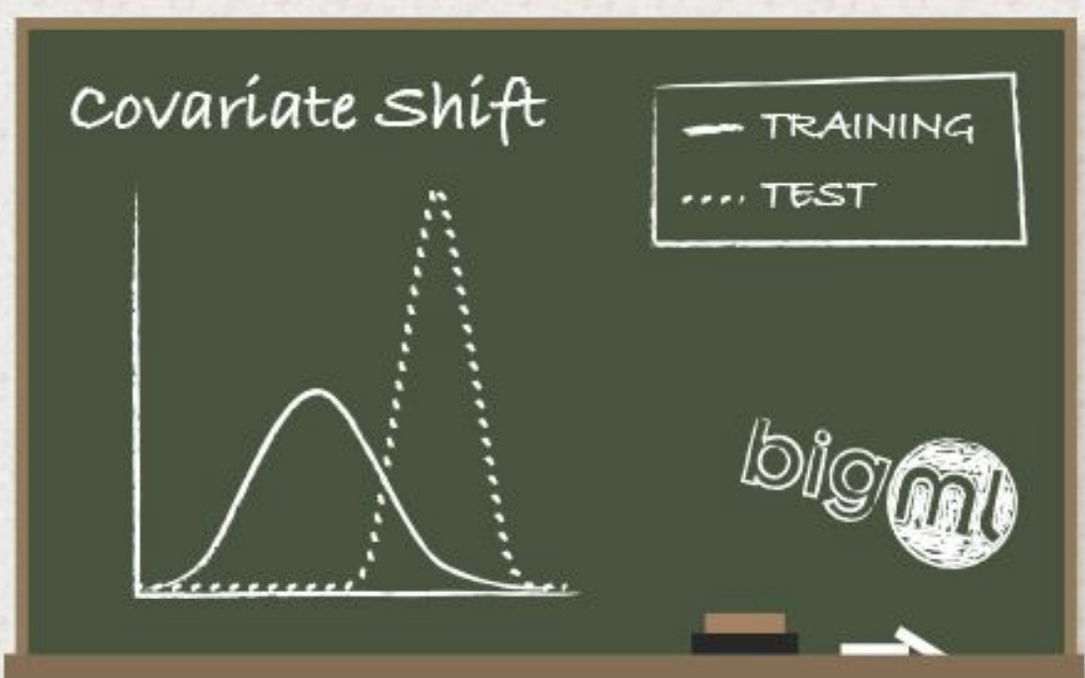
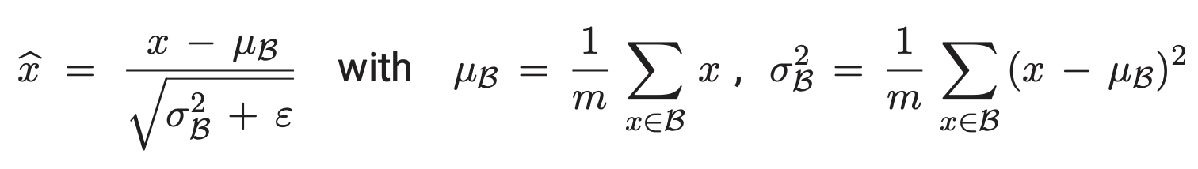
Normalization
Internal Covariate Shift: As network parameters change during training, the distributions of the input values to each layer change.
Training could be more efficient if the layers were receiving inputs with a fixed distribution throughout the entire process.
Batch normalization reduces the internal covariate shift (ICS) and accelerates the training of a deep neural network.
The proposed batch normalization technique corresponds to first performing a normalization with respect to the batch statistics.
where m is a fixed batch size, and ε > 0 for numerical stability.
Disadvantage: can not be applied for test data. Hence, average and standard deviation values of training data is used.

Slide 28
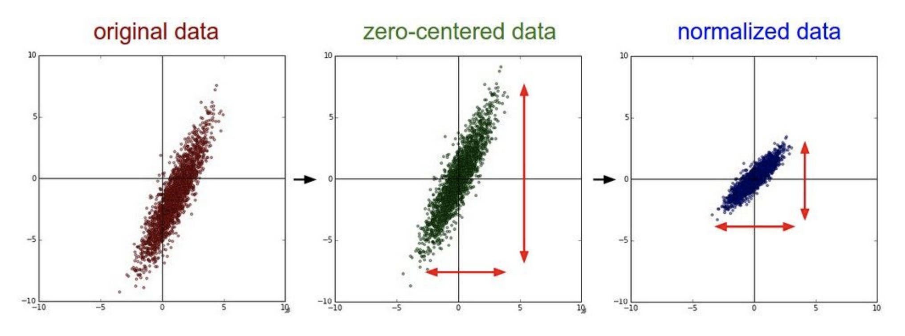
Normalization

Slide 29
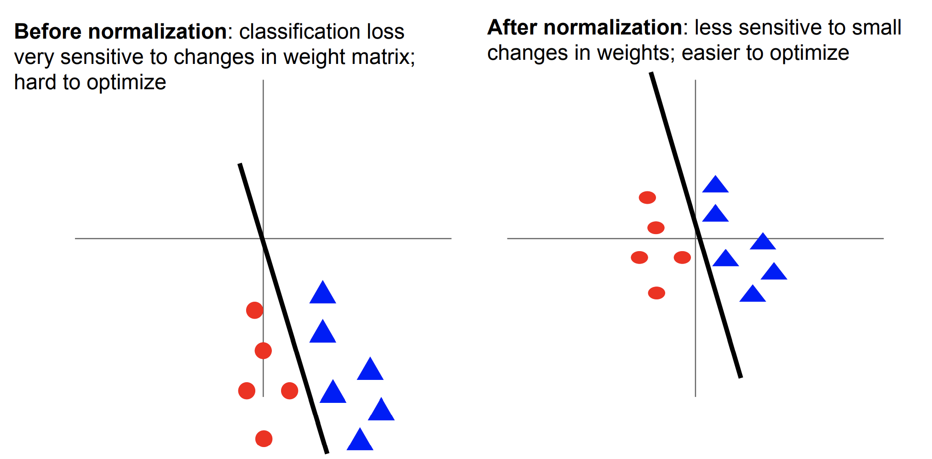
Normalization

Slide 30
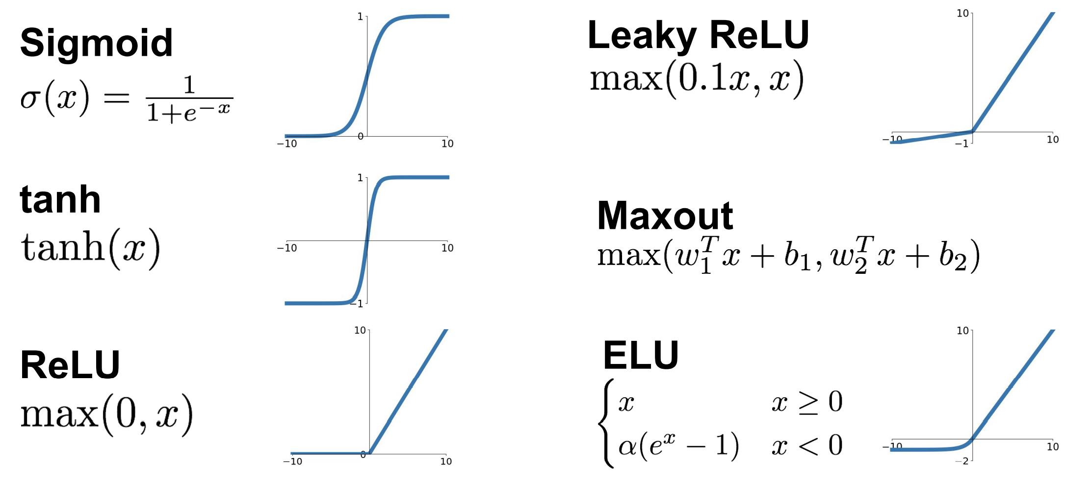
Activation Functions

Slide 31
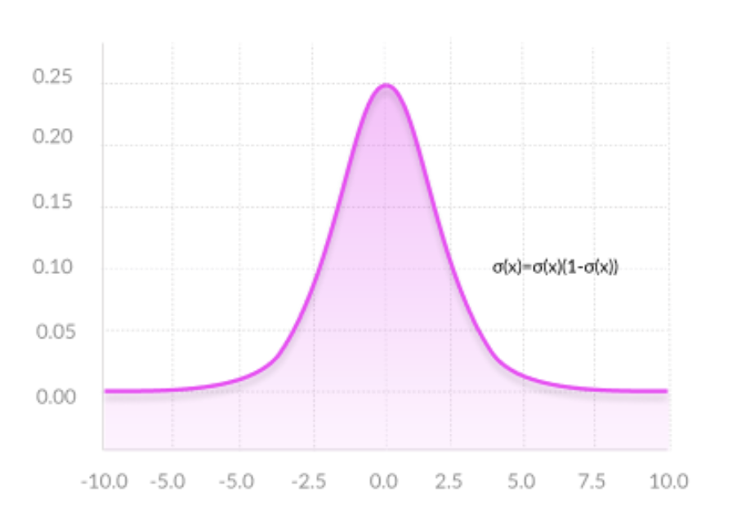
Activation Functions
Smooth gradient
Output range between [0,1]
Mostly used at output layer for two class classification
Vanishing Gradient Issue for larger or smaller values of input
Output is not zero centered

Slide 32
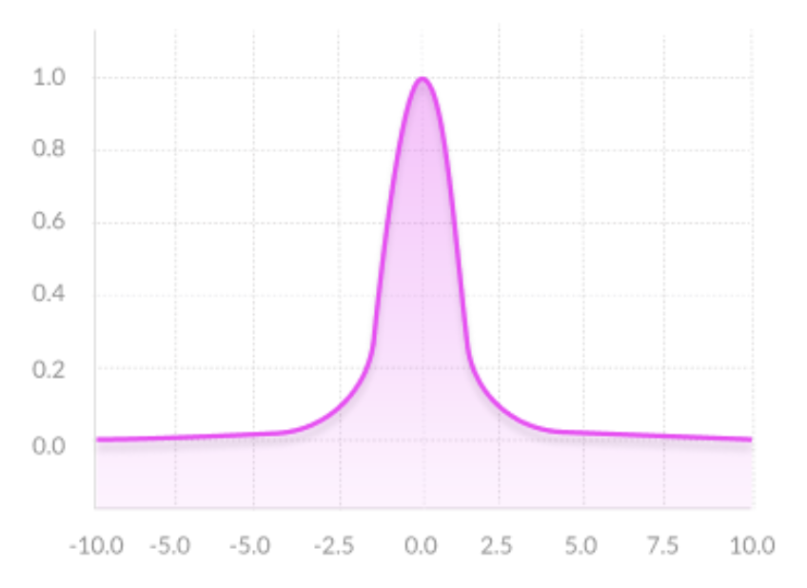
Activation Functions
Output is Zero Centered
Ideal for output prediction of positive as well as negative values
Smooth gradient
Vanishing Gradient Issue for larger or smaller values of input

Slide 33
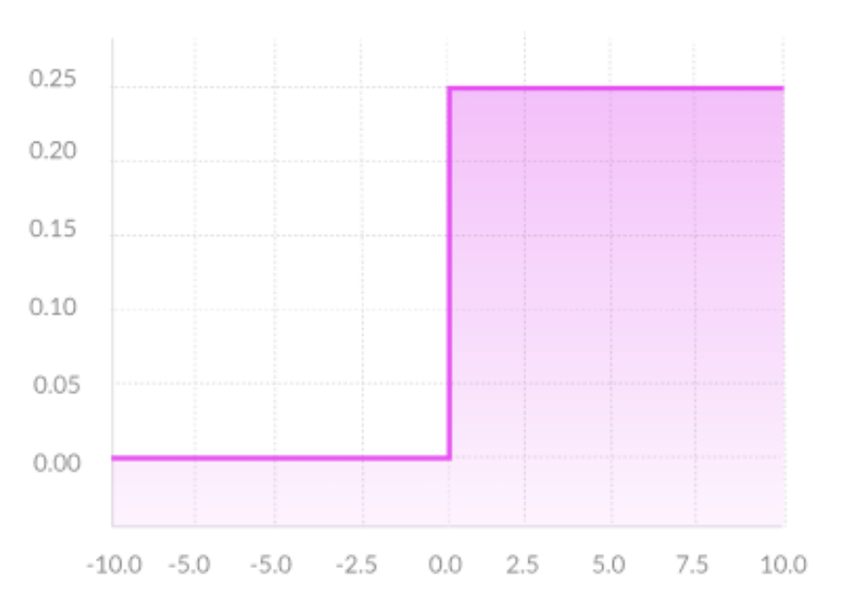
Activation Functions
ReLU - Rectified Linear Unit
Most used activation function
Computationally efficient
Mostly used at hidden layer of the network
when inputs approach zero, or are negative, the gradient of the function becomes zero, the network cannot perform backpropagation and cannot learn

Slide 34
Activation Functions
ReLU - Rectified Linear Unit
Computationally efficient
Mostly used at hidden layer of the network
Small positive slope in the negative area enables backpropagation, even for negative input values
Parametric ReLU as learning negative slope

Slide 35
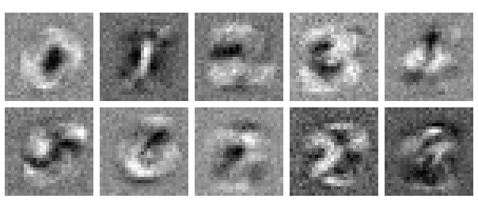
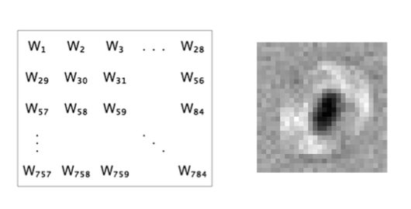
Visualise Weights
In single-layer and multi-layer neural networks, each layer has a similar function; it transforms data from the previous layer into a “higher-level” representation of that data. By “higher-level,” we mean that it contains a compact and more salient representation of that data, in the way that a summary is a “high-level” representation of a book. For example, in the 2-layer network above, we mapped the “low-level” pixels into “higher-level” features found in digits (strokes, loops, etc) in the first layer, and then mapped those high-level features into an even higher-level representation in the next layer, that of the actual digits. This notion of transforming data into smaller but more meaningful information is at the heart of machine learning, and a primary capability of neural networks.

Slide 36
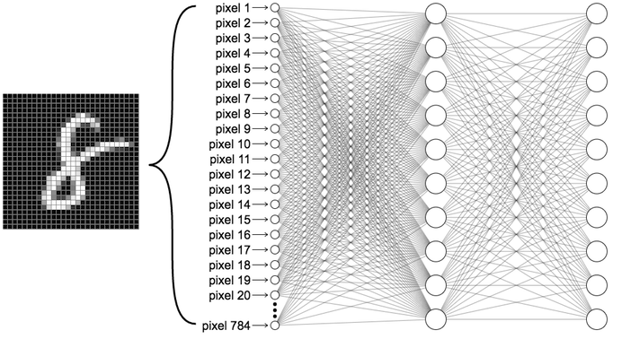
Visualise MNIST Weights

Slide 37
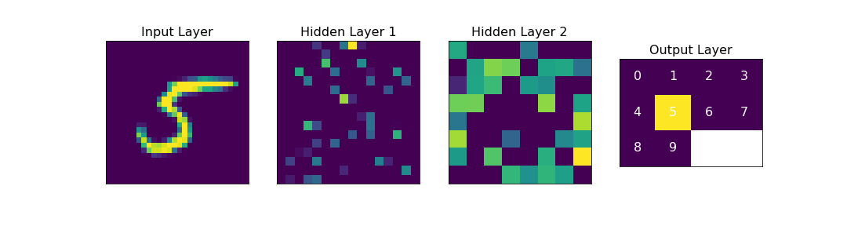
Visualise MNIST Weights
We can also visualize the inputs and outputs of each layer in the network.
the original 28x28 pixel frame depicting a hand-written figure,
the output values of all neurons of the first hidden layer,
the output values of all neurons of the second hidden layer, and
the one-hot encoded output layer indicating the model classification result.

